Slide 1

Movie Recommendation System
Presentation by Group 9

Slide 2
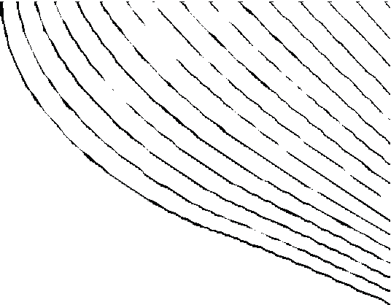


OUR TEAM OF DATA SCIENTISTS
01
02
03
04
05
06
RUTH KITASI
AGATHA NYAMBATI
JOSELINE APIYO
CECILIA NGUNJIRI
JOHN MBEGO
LEONARD KOYIO

Slide 3


INTRODUCTION
In todays world of massive data growth, recommendation systems have become essential tools for filtering information and enhancing user experiences. These system help users find the relevant content by analyzing their past behaviors, such as queries or browsing histories.

Slide 4
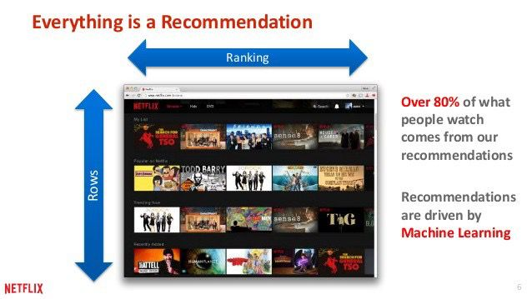
With the vast amount of content available in our streaming platforms, majority of users often feel overwhelmed by making choices, hence difficulties in discovering movies that align with their preferences.
Movie lens has tasked our team of data scientists with optimizing their recommendation system through data-driven approaches.
By analyzing user behaviors and preferences, we aim to enhance system ability to deliver personalized movie recommendations..
PROBLEM STATEMENT

Slide 5
OBJECTIVES
Develop a personalized Recommendation System.
Implement Content Based Filtering for Existing Users.
Mitigate the Cold Start Problem by :
Promoting Movie Popularity.
Content-Based Filtering.
Evaluate The Recommendation System Performance.
Analyze Movie Rating Frequency.

Slide 6




OVERVIEW
Descriptive Statistics Data Visualization Machine Learning Recommendation system
Exploratory Data Analysis
Feature Selection
Modelling
Recommendation

Slide 7

IMPORTANT VARIABLES
R A T I N G S
TITLE
GENRES
USER ID
These are variables that will be used to build the recommendation system

Slide 8
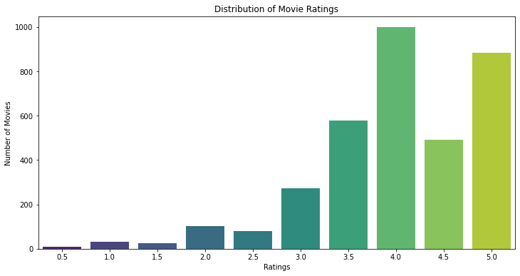
VISUALIZATIONS
.
From the graph above, majority of the movies has a higher rating with an average of 4.0.

Slide 9
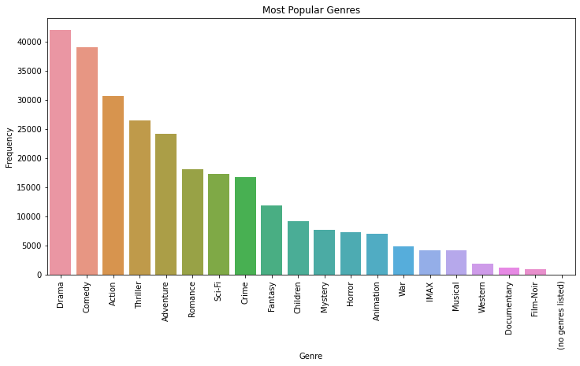
GENRE POPULARITY
The gragh shows that the genres "Drama" and "Comedy" are the most popular among the movies in the dataset, with significantly higher counts compared to other genres.
Genres such as "Western," "Horror," "Musical," "Film-Noir," "IMAX," and "Documentary" have relatively low counts, indicating they are less frequently represented in the dataset.

Slide 10
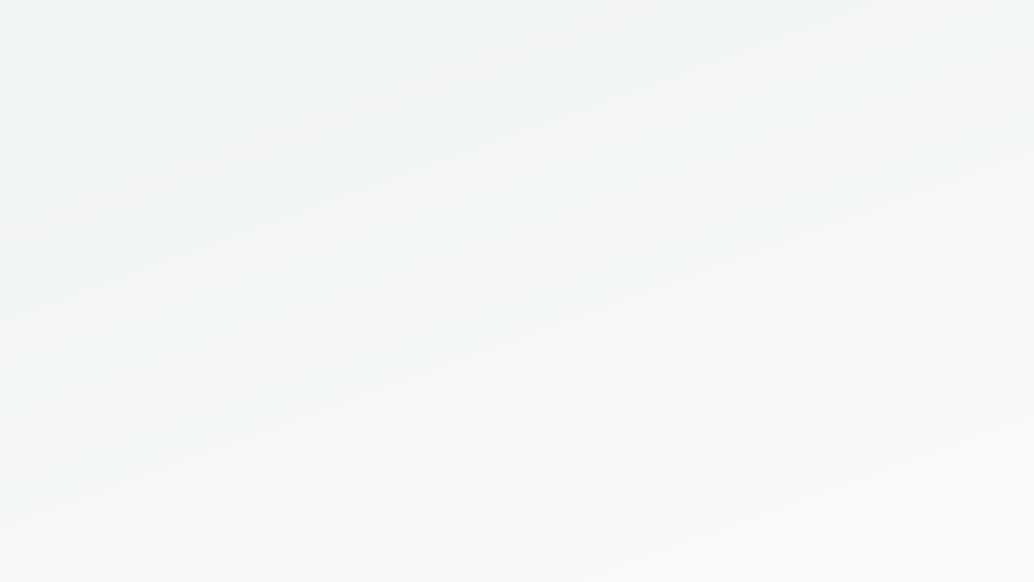




BEST MODEL : OPTIMIZED SVD MODEL
success metric: error close 0 our error range: 3 to 4 verdict: moderately accurate
Users are able to discover new books that they may not have been aware of or considered before , by analyzing similarities between users SVD can recommend most rated books among similar users
IMPLICATION
personalized recommendations on new users is not accurate due to lack of initial data stemming from their interaction with the website
the error metric is interpretable with close to zero being perfect, this has the lowest error of 3
JUSTIFICATION
LIMITATION

Slide 11








Enhanced Accuracy with SVD and Hyperparameter Tuning:
Effective Collaborative and Content-Based Filtering:
CONCLUSION
Successful Cold Start Mitigation.
Model Success:
The combined approaches of collaborative filtering, content-based filtering, and cold-start mitigation provided robust and personalized movie recommendations.

Slide 12
Recommendations
Update the Dataset: Continuously add new movie releases to keep recommendations aligned with current audience preferences and trends.
Include Filmmaker Information: Enhance the dataset with details about screenwriters and producers
3. Expand Genre Classifications: Broaden genres to include niche and diverse categories, making the platform more inclusive and encouraging user exploration.

Slide 13
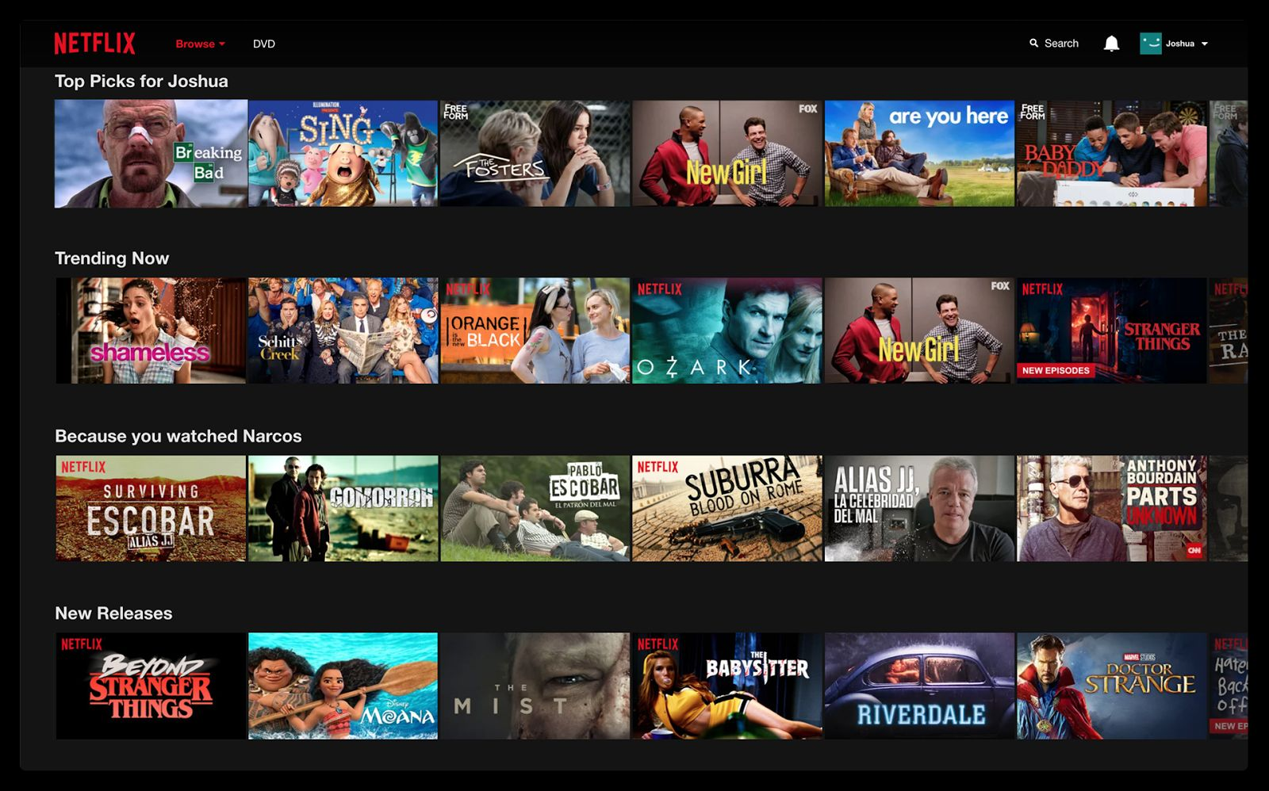
DEPLOYED CLIP
This was deployed lets see some of the recommendations and how relevant they are:
Genres and movie titles
the novel was 1st to die by James patterson, the recommendation are books by the same author same genre and not that '2nd chance' is the part 2 in the book series of 1st to Die
accuracy has hit the mark !

Slide 14
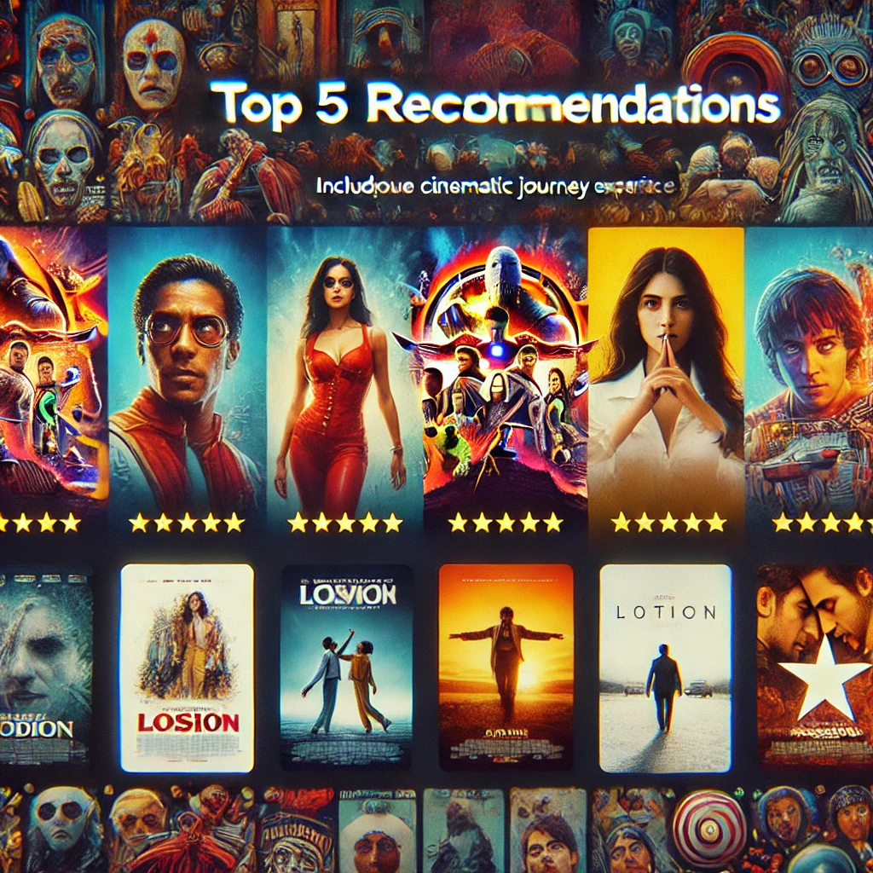
"A good movie is always worth watching twice. A great recommendation helps you discover it the first time."

